Slide 1
CHRONIC KIDNEY DISEASE PREDICTION
Under the Guidance of:
Dr K Rameshwaraiah
Batch-6
Pulipaka Tirumala Suryateja
(207Z1A05D3)
P Naga Sai Bharath
(207Z1A05D2)
P Madhusudhan Reddy
(207Z1A05C9)

Slide 2

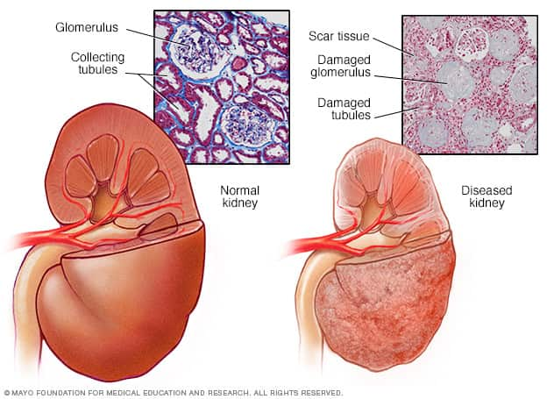
INTRODUCTION
Chronic kidney disease (CKD) is a major issue worldwide which is a condition characterized by a gradual loss of kidney function over time.
14% of the world population suffer from CKD.
Chronic kidney disease causes more deaths than breast cancer or prostate cancer .
To predict positive CKD status and the stages of CKD machine learning can be used.

Slide 3
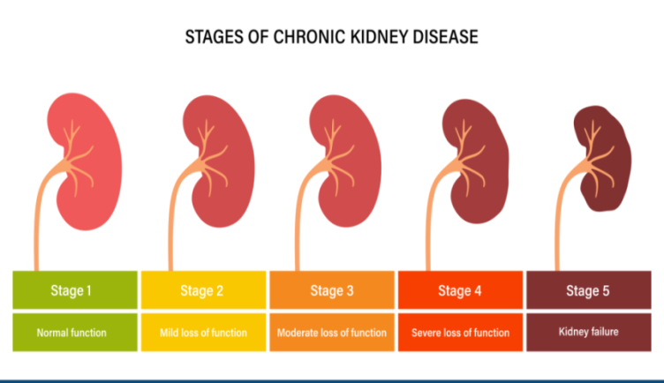
PROBLEM STATEMENT
Chronic kidney disease includes conditions that damage your kidneys
The existing traditional way how doctors find this problem is by examining the various tests performed on the human kidney.
Though it is very much accurate, this process is time consuming.
A very easily handled method needs
to be used to predict this kidney
failure symptoms more accurately.

Slide 4
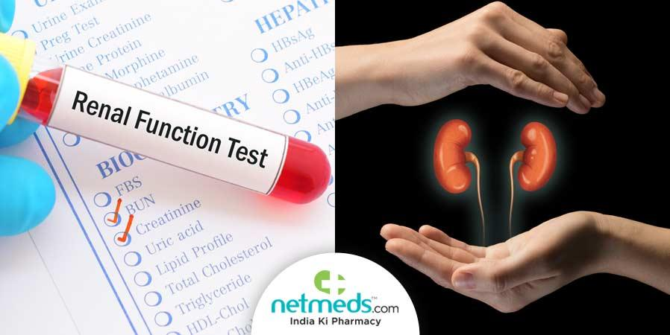
EXISTING SYSTEM
The main test for identifying a kidney disease is blood test- eGFR, Serum creatine test,Blood urea nitrogen test.
Along with them Urine test,Kidney ultrasound and kidney biopsy are also needed.
But these tests are time consuming and are high cost.

Slide 5

PROPOSED SYSYTEM
Predicting CKD using machine learning concept.
Application of machine learning methods to predict CKD has been explored based on multiple data sets.
The difference in between the traditional tests and this method is that it gives us a more accurate report.
We use Machine Learning
Algorithms like Random
Forest to obtain the desired
results.

Slide 6
SYSTEM REQUIREMENTS
HARDWARE REQUIREMENTS:
System : Pentium i3 Processor
Hard disk : 512GB
Monitor : 15”LED
RAM : 4GB
SOFTWARE REQUIREMENTS:
Operating system : Windows 10
Python3
Python IDE: Pycharm

Slide 7
MODULES
Chronic Kidney Data.
Missing Values and Preprocessing.
Feature Selection.
Training and Testing Dataset.
Model Training and Evaluation.

Slide 8
MODULES
Chronic Kidney Data:
The Chronic Kidney Data module forms the foundation of our analysis.
It involves the collection and initial exploration of data related to chronic kidney disease.
This dataset contains valuable information, such as patient demographics, medical history, and test results.
Missing Values and Preprocessing:
In the Missing Values and Preprocessing module, we address the issue of missing data in our dataset.
Missing data can significantly impact the quality of our analysis and machine learning models.
Data preprocessing involves steps like data cleaning, normalization, and transformation, ensuring that our dataset is ready.

Slide 9
MODULES
Feature Selection:
Feature Selection is a crucial module where we identify and choose the most relevant features or attributes from our dataset.
Carefully selecting features can improve model performance, reduce dimensionality, and enhance interpretability.
Training and Testing Dataset:
In this module, we split our preprocessed dataset into two subsets: the training dataset and the testing dataset.
The testing dataset remains unseen during training and serves as an independent evaluation set, helping us assess the model's generalization performance and make predictions on new, unseen data.

Slide 10
MODULES
Model Training and Evaluation:
The Model Training and Evaluation module is the heart of our analysis. Here, we employ various machine learning algorithms to train predictive models using the training dataset.
We fine-tune and optimize these models to achieve the best possible performance. Subsequently, we evaluate model accuracy, precision, recall, and other relevant metrics using the testing dataset to assess how well our models generalize to real-world scenarios.
This module plays a pivotal role in our mission to predict and understand chronic kidney disease based on the provided data.

Slide 11
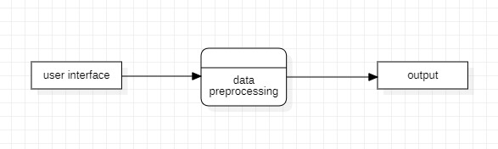
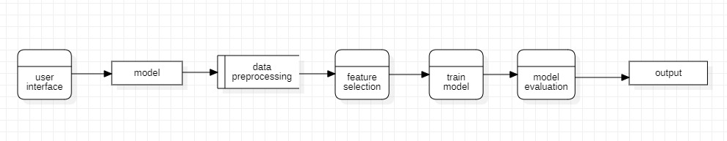
DATA FLOW DIAGRAM LEVEL 0
LEVEL 1

Slide 12
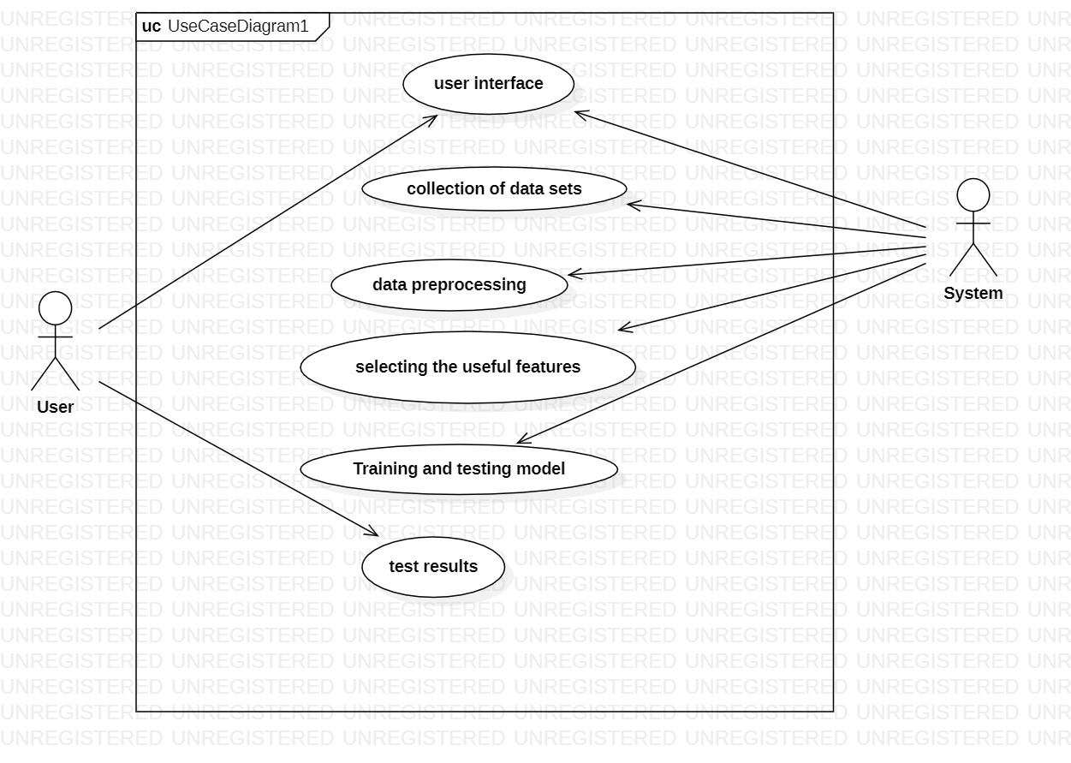
UML Diagrams
USECASE DIAGRAM -

Slide 13
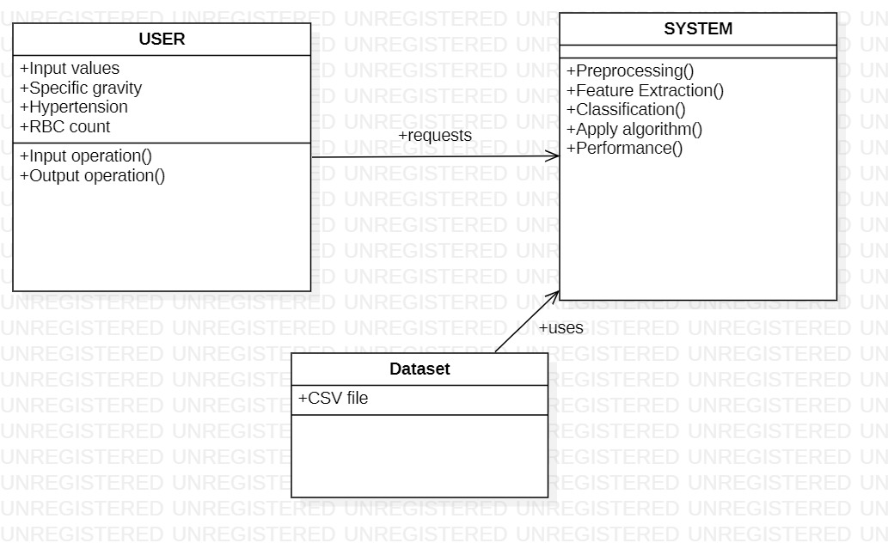
UML Diagrams
CLASS DIAGRAM

Slide 14
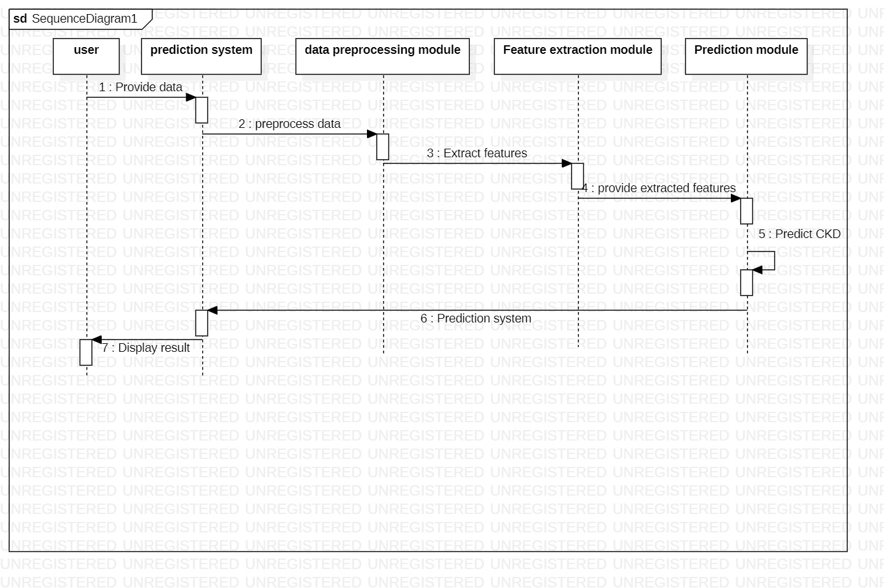
UML Diagrams
SEQUENCE DIAGRAM

Slide 15
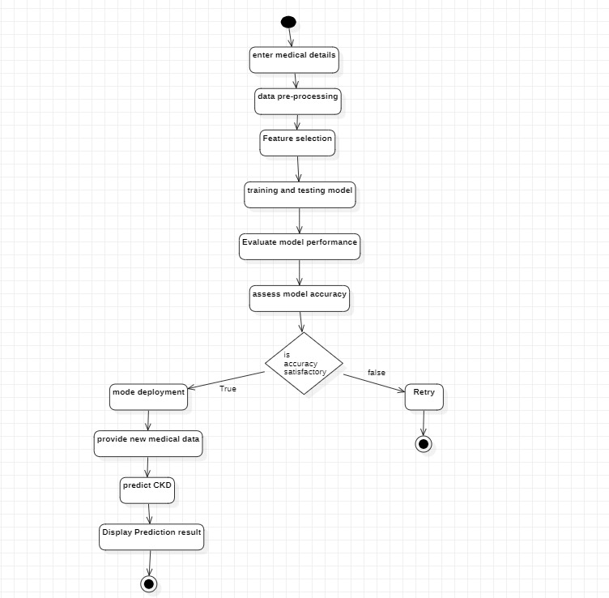
UML Diagrams
ACTIVITY DIAGRAM

Slide 16
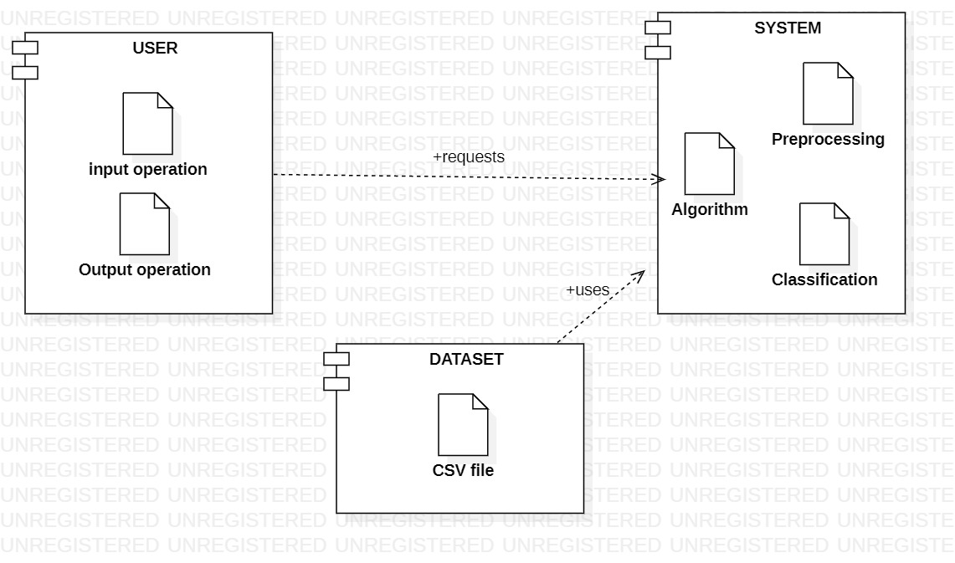
UML Diagrams
COMPONENT DIAGRAM -

Slide 17
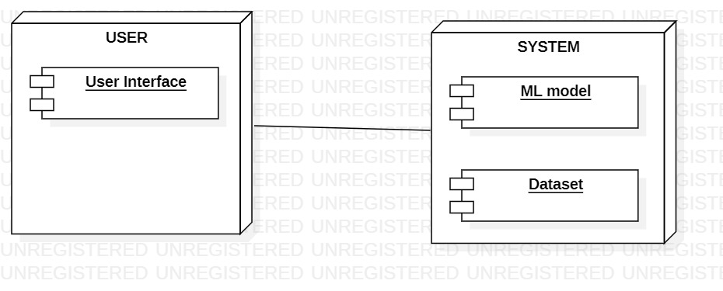
UML Diagrams
DEPLOYMENT DIAGRAM

Slide 18
CONTROL FLOW OF THE PROGRAM
Chronic Kidney Data.
Missing Values and Preprocessing.
Feature Selection.
Training and Testing Dataset.
Model Training and Evaluation.

Slide 19
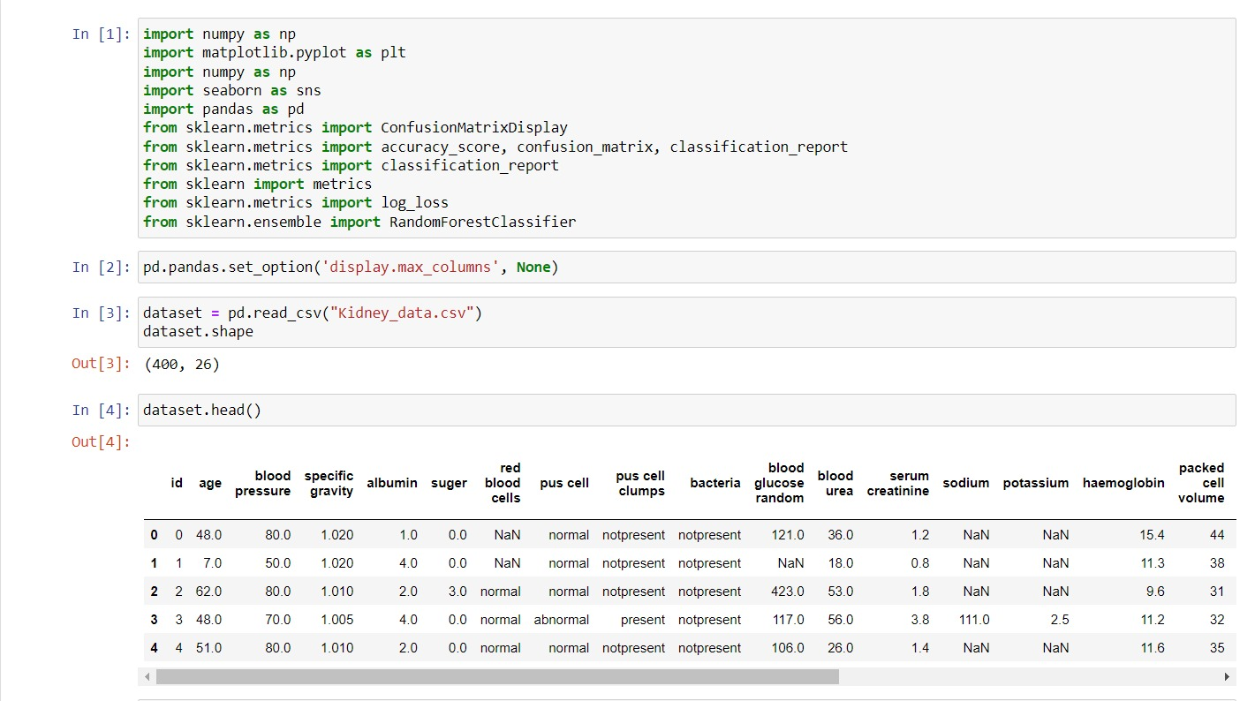
CHRONIC KIDNEY DATA

Slide 20
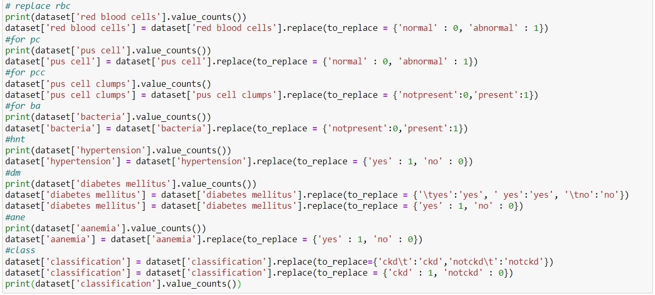
MISSING VALUES AND PREPROCESSING

Slide 21
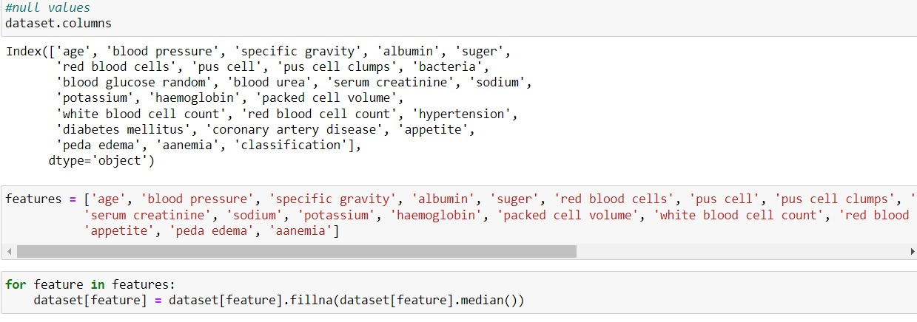
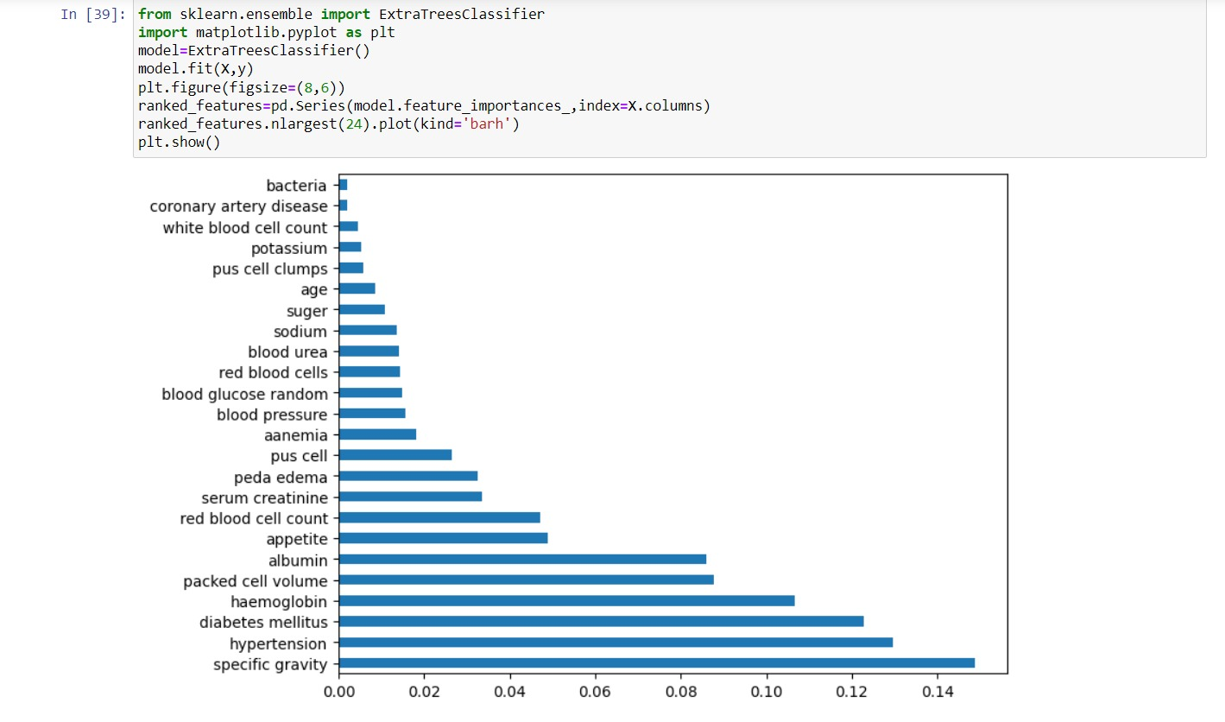
MISSING VALUES AND PREPROCESSING
FEATURE SELECTION

Slide 22
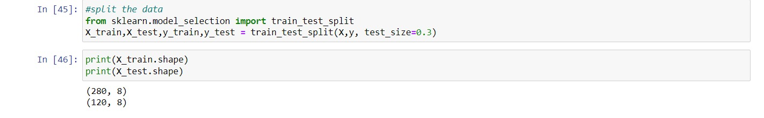
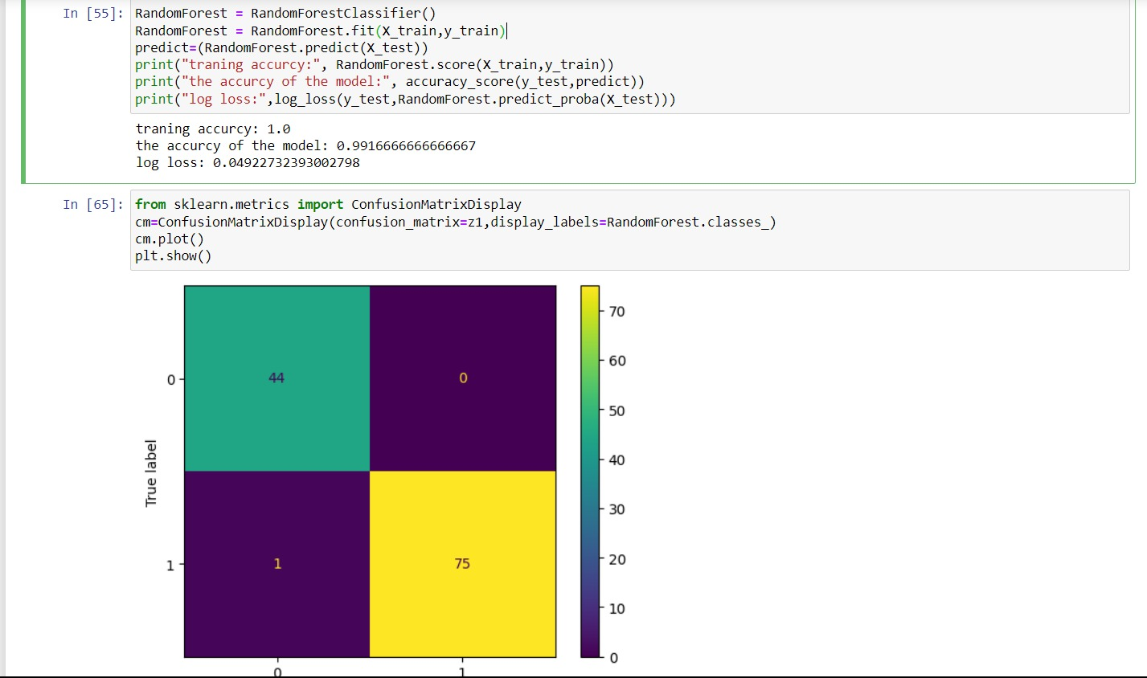
TRAINING AND TESTING DATASET
MODEL TRAINING AND EVALUATION

Slide 23
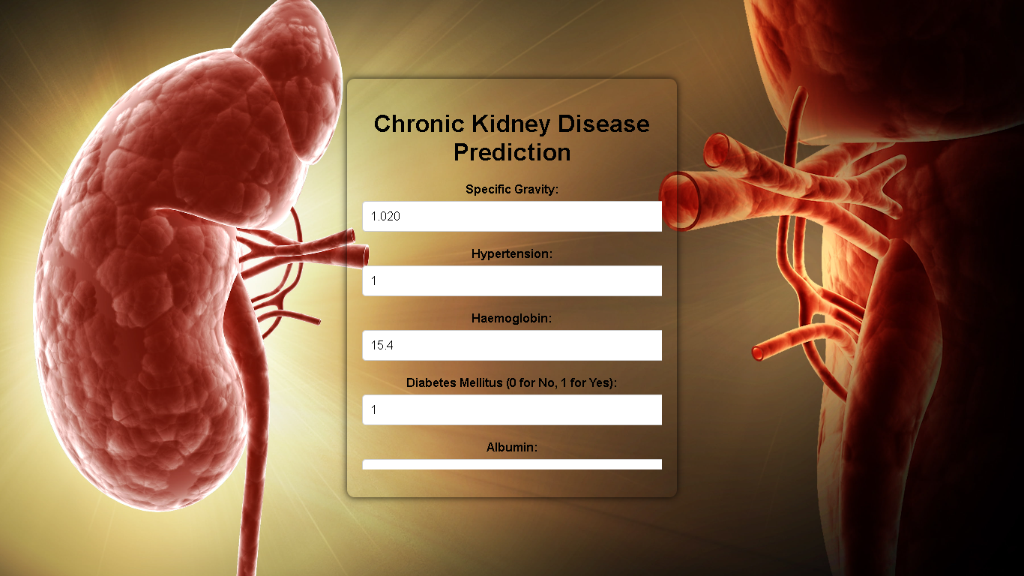
USER INTERFACE

Slide 24
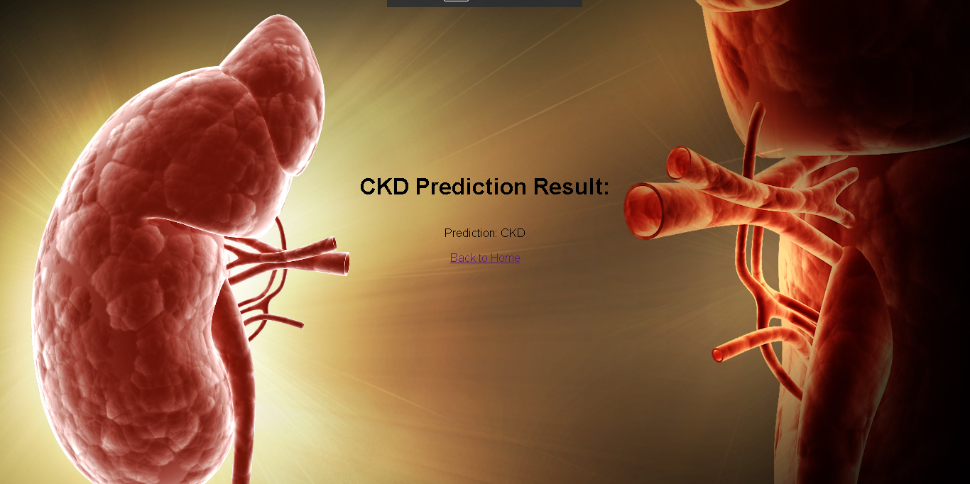
USER INTERFACE

Slide 25
TEST CASES
Test Case ID | Test Case Description | Test Steps | Input Test Data | Expected Result | Actual Result | Status
TC01 | Input Validation Test | 1. Enter patient data with missing values. | Missing age, gender, or other required fields | Display appropriate error message for missing data. | Error message displayed as expected. | Passed
TC02 | Data Preprocessing Test | 1. Preprocess the CKD dataset. | Raw CKD dataset | Dataset is cleaned and ready for feature selection. | Preprocessing completed successfully. | Passed
TC03 | Feature Selection Test | 1. Perform feature selection. | Preprocessed CKD dataset | Select relevant features for CKD prediction. | Relevant features selected as expected. | Passed
TC04 | Training and Testing Dataset Split Test | 1. Split the dataset into training and testing sets. | Preprocessed CKD dataset | Training set contains 70%, testing set 30%. | Dataset split as per the specified ratio. | Passed
TC05 | Model Training Test | 1. Train the selected ML classifier. | Training dataset | Model trained without errors. | Model trained successfully. | Passed
TC06 | Prediction Test | 1. Provide new patient data for prediction. | New patient data | Model predicts CKD status (positive/negative). | Model prediction matches the expected result. | Passed

Slide 26
TEST CASES
TC07 | Evaluation Metrics Test | 1. Calculate evaluation metrics for the model. | Predictions and actual CKD status | Display accuracy, precision, recall, F1-score, etc. | Metrics calculated correctly. | Passed
TC08 | User Interface Test | 1. Interact with the user interface. | UI for data input and result display | User can input data, view predictions, and info. | UI is user-friendly and functional. | Passed
TC09 | Performance Test | 1. Measure response times for prediction requests. | Prediction request | Response time within acceptable limits. | Response time meets performance criteria. | Passed
TC10 | Security Test | 1. Verify data security and privacy measures. | Data handling and storage procedures | Data is securely handled and protected. | Data security measures in place. | Passed
TC11 | Error Handling Test | 1. Simulate unexpected errors in the system. | Trigger unexpected errors | Informative error messages are displayed. | Error handling works as expected. | Passed
TC12 | Integration Test | 1. Test system integration with external systems. | External systems or databases used | Integration with external systems is seamless. | Integration is successful. | Passed

Slide 27
REFERENCES
Your Kidneys & How They Work
https://www.niddk.nih.gov/health-information/kidney-disease/kidneys-how-they-work
Kidney Diseases
https://www.kidney.org/news/newsroom/factsheets/KidneyDiseasBasics

Slide 28
CONCLUSION
We conclude that , with the help of our CKD prediction using machine learning we can reduce the manpower.
This model gives fast access,high flexibility and efficiency.
This model is a new age upgrade for avoiding the major CKD health issue.

Slide 29
THANK YOU

